Slide 1
Image Scraping and Classification Project

Slide 2
Images are one of the major sources of data in the field of data science and AI. This field is making appropriate use of information that can be gathered through images by examining its features and details. We are trying to give you an exposure of how an end to end project is developed in this field.

Slide 3
Data Collection Phase:
You need to scrape images of these 3 categories and build your data from it. That data will be provided as an input to your deep learning problem. You need to scrape minimum 200 images of each categories.
After the data collection and preparation is done, you need to build an image classification model that will classify between these 3 categories mentioned above

Slide 4
selenium
Selenium is used for image scrapping
# Importing Libraries
import selenium
import pandas as pd
import time
from bs4 import BeautifulSoup
# Importing selenium webdriver
from selenium import webdriver
These are library which used for collected data

Slide 5
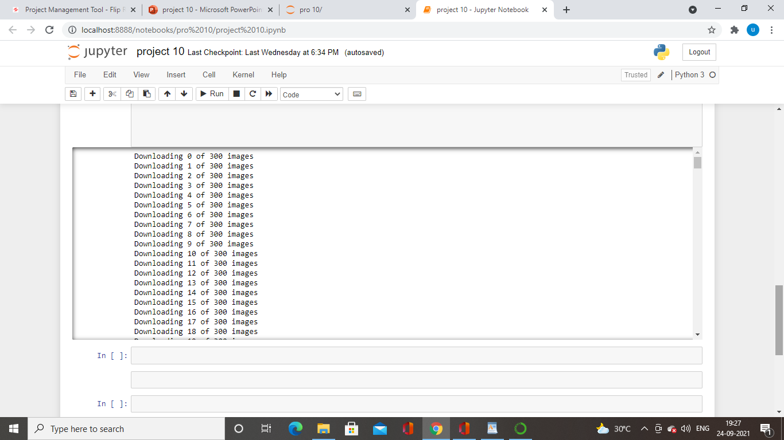
Web driver
Webdriver is used for image scrapping
Flipkart is used for webscrapping

Slide 6
Deep learning
. That data will be provided as an input to your deep learning problem
from tensorflow.keras.layers import Input, Lambda, Dense, Flatten
from tensorflow.keras.models import Model
from tensorflow.keras.applications.vgg16 import VGG16
from tensorflow.keras.applications.vgg16 import preprocess_input
from tensorflow.keras.preprocessing import image
from tensorflow.keras.preprocessing.image import ImageDataGenerator
from tensorflow.keras.models import Sequential

Slide 7
Sample image
import cv2
width, height= 224, 224
img = cv2.imread('/content/drive/MyDrive/project 10/train/Jeans (men)/folder10.jpg')
img_resized = cv2.resize(img,(width, height))
In this coding we will have the sample image

Slide 8
Rgb & bgr
plt.imshow(cv2.cvtColor(img_resized, cv2.COLOR_BGR2RGB))
In this coding we will converting into rgb into bgr
test_datagen = ImageDataGenerator(rescale = 1./255)
In this coding we will be using image datagenerator for image in each pixcel

Slide 9
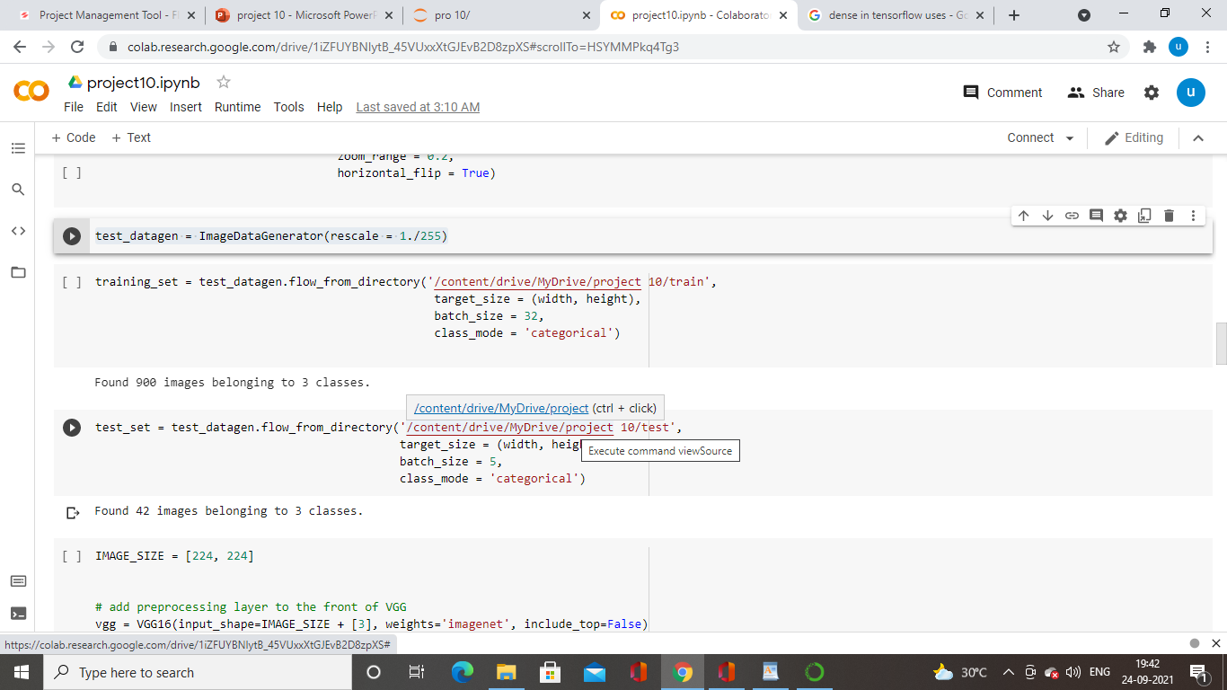
Getting data from drive train and test

Slide 10
preprocessing layer VGG
Getting image from vgg
Using image net for huge data
include_top=False
Which is used getting only few layer

Slide 11
# useful for getting number of classes
folders = glob('/content/drive/MyDrive/project 10/train/*')
# our layers - you can add more if you want
x = Flatten()(vgg.output)
#x = Dense(1000, activation='relu')(x)
prediction = Dense(len(folders),activation='softmax')(x)
# create a model object
model = Model(inputs=vgg.input, outputs=prediction)
# view the structure of the model
model.summary()

Slide 12
Model and optimization method
model.compile(
loss='categorical_crossentropy',
optimizer='adam',
metrics=['accuracy']
)

Slide 13
Fit generator
r = model.fit_generator( training_set,validation_data=test_set,epochs=2)
Epoch 1/2 29/29 [==============================] - 471s 16s/step - loss: 0.4936 - accuracy: 0.8267 - val_loss: 0.0565 - val_accuracy: 0.9762
Epoch 2/2 29/29 [==============================] - 460s 16s/step - loss: 0.0386 - accuracy: 0.9967 - val_loss: 0.0213 - val_accuracy: 1.0000

